Slide 1
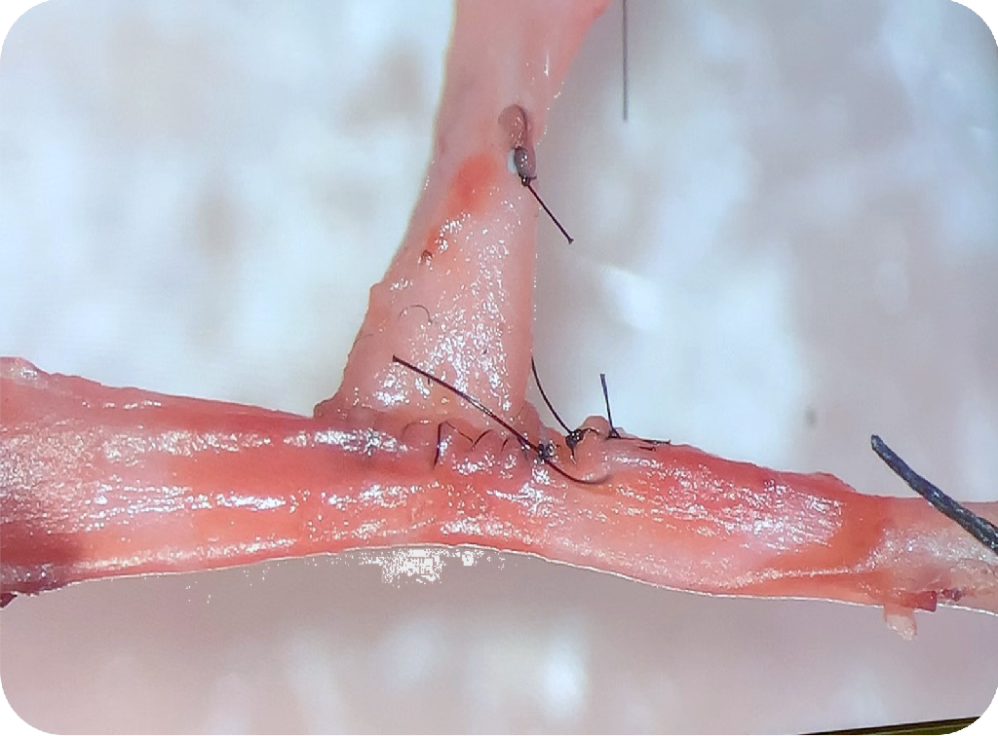
ONLINE COURSE ON MICROSURGERY IN EXPERIMENTAL TRANSPLANTATION MODELS (4th Edition)
Training and Research - LA PAZ UNIVERSITY HOSPITAL
EMAIL TO REGISTER :
donaciones@idipaz.es
Available until September 1st 2025
GENERAL INFORMATION
Information and Technical
Secretary: Irene Cuevas
Phone: 917277154
E mail: irene.cuevas@salud.madrid.org
The Microsurgery in Experimental Transplantation Models Course available at https://cursosceasec.es/ and organised by ERN-Transplantchild is accredited by the European Accreditation Council for Continuing Medical Education (EACCME®) to offer the following CME activity for medical specialists.
Registration fee: 100 €

Slide 2
GENERAL OBJECTIVES
To acquire the basic knowledge of microsurgery in research in experimental transplantation models.
To learn the technique of the different solid organ transplants that can be carried out in experimental models.
Theoretical Content
History of experimental microsurgery.
Magnification elements: magnifying loupes and microscopes, sutures and microsurgical instruments.
Ethics and animal welfare.
Clinical application of microsurgery.
Simulation models - Level 1: gauze, macro mute and knotting using microscope.
Simulation models - Level 2: synthetic flat and ductal sutures.
Simulation models - Level 3: suturing of cryopreserved material.
Research with experimental transplantation models.
Vascular suturing in transplantation models.
Experimental models: cardiac transplantation, lung transplantation, renal transplantation, liver transplantation, isolated intestinal transplantation, modified multivisceral transplantation.
SPECIFIC OBJECTIVES
To know how to handle correctly the microsurgical instruments.
To become aware of working with live models in teaching and research.
To become familiar with the applications of microsurgery in clinical surgical practice.
To know how to reproduce inanimate simulation models for a reproducible microsurgical practice in any health care centre.
Learn and know how to reproduce the technique of donation and implantation in the different solid organ transplant models proposed.
Directors:
Dr. Francisco Hernández Oliveros
Dr. Javier Serradilla Rodríguez
Dr. Pablo Stringa
Faculty members:
Dr. Francisco Hernández Oliveros (Clinical Chief in Paediatric Transplantation - HULP)
Dr. Javier Serradilla Rodríguez (FEA Paediatric Surgery - HULP)
Dr. Pablo Stringa (CONICET Researcher, Chair of Trasplantation, FCM UNLP Argentina)
Dr. Leandro Vecchio (CONICET Researcher, Chair of Trasplantation, FCM UNLP Argentina)
Dr. Juan Cruz Abate Zárate (FEA General Surgery – Transplant research HULP)
Dra. Natalia Lausada (Researcher, Chair of Trasplantation - FCM UNLP Argentina)
Dra. Ane Miren Andrés Moreno (FEA Paediatric Surgery - HULP)
Dra. María Velayos López (FEA Paediatric Surgery – HULP)
Dra. Carlota Largo Aramburu (Veterinary Experimental Surgery - HULP)
Dr. Daniel Ruiz Pérez (Training Officer, Comparative Medicine Unit- Trinity College Dublin)
Dra. Alba Sánchez Galán (FEA Paediatric Surgery - HULP)
Javier Rubio Bolívar (Simulation Technician - HULP)

